Slide 1

Electricity consumption analyzer

Slide 2
Worked and presented to you by:
Zeyad Saad Abdel-Fattah
Joesph George Wahba
Muhammed Ashraf El-Kateb
Zyad Gamal Saeed
Menna-Allah Ahmed
Abdelhalim Ramadan

Slide 3

Why to build the system?
How to structure the project?
1. Rising Electricity Costs
Many households struggle with managing their electricity bills due to increasing rates and unpredictable consumption patterns.
2. Lack of Awareness
Users often don’t have a clear understanding of how much electricity they are using until they receive their bill.
3. Environmental Impact
Efficient energy usage can reduce overall consumption, which benefits the environment by lowering carbon footprints.
4. Convenience and Control
The system provides real-time updates on electricity consumption, helping users to stay within their budget and avoid unexpected expenses.
5. AI-Powered Insights
By integrating AI, the system offers personalized tips to optimize energy usage, leading to long-term savings and more energy-conscious behavior.

Slide 4

How to structure the project?
1. Requirements Gathering
Identify User Needs: Understand the target audience's pain points regarding electricity consumption and cost management
Define System Requirements: Specify core features such as consumption tracking, notifications, and AI recommendations
2. System Design
App Interface Design: Create an intuitive user interface for tracking consumption and receiving alerts
Backend Development: Design the system’s architecture, focusing on data collection, real-time analysis, and integration with AI algorithms
AI Algorithm Development: Build and train the machine learning model that provides energy-saving tips based on user data
3. Data Collection & Integration
Consumption Data: Collect real-time electricity usage data from smart meters or manual input by users
User Profile Data: Gather data on user habits (e.g., time of peak usage, appliance usage) for AI training

Slide 5
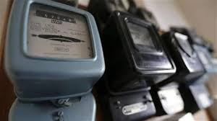
How to structure the project?
4. Development Phases
Phase 1: Prototype Development: Build a functional prototype of the app with core features (usage tracking, alerts).
Phase 2: AI Integration: Implement and train the AI algorithm for personalized energy-saving suggestions.
Phase 3: Testing & Iteration: Conduct user testing to refine features, UI, and the accuracy of AI predictions.
5. Final Implementation and Launch
Testing & Debugging: Ensure system reliability, accuracy, and usability.
Deployment: Launch the application with cloud integration for scalability.
Post-launch Support: Gather feedback and improve the app with new features and updates

Slide 6
The advantages and disadvantages of each type of electricity meter available in Egypt:
1. Conventional (Mechanical) Meters
Advantages:
Simple and easy to use.
Lower cost compared to digital meters.
Does not require electricity to operate.
Disadvantages:
Less accuracy in measurement compared to digital meters.
Difficulty reading values in low light conditions.
Does not provide additional information about consumption.

Slide 7
2. Digital (Electronic) Meters
Advantages:
-High accuracy in measurement.
-Easy-to-read digital display.
-Provides additional information, such as energy consumption over different time periods.
Disadvantages:
-Higher cost than conventional meters.
-Dependent on a power source to operate (for the display).
-May be prone to electronic malfunctions.
3. Smart Meters
Advantages:
-Provides real-time data on consumption.
-Enables remote reading, simplifying the billing process.
-Helps manage energy usage and reduce bills.
Disadvantages:
-Higher initial cost.
-Requires infrastructure for information technology.
-Concerns regarding privacy and data security.

Slide 8
4. Prepaid Meters
Advantages:
-Better control over energy consumption, as payment is made before use.
-Avoids surprise bills.
-Offers notifications when the balance is running low.
Disadvantages:
-Service can be interrupted if there isn’t enough balance.
-Some users prefer to pay after consumption.
-May require adjustment time to adapt to the prepaid system.
5. Three-Phase Meters
Advantages:
-Suitable for industrial and commercial uses.
-Provides precise data on consumption for each phase.
-Helps in better load distribution.
Disadvantages:
-Higher cost than single-phase meters.
-Requires complex installation and specialized maintenance.
-May be unnecessary for household use.

Slide 9
Electricity meter manufacturers in Egypt
1. Kahraba Meter Company (Kahromieter)
Conventional (Mechanical) Meters
Digital Meters
Prepaid Meters
2. Schneider Electric
Smart Meters
Three-Phase Meters
3. Siemens
Three-Phase Meters
4. Energia
Prepaid Meters
Digital Meters
5. Egyptian Electricity Manufacturing Company
Conventional Meters
Digital Meters

Slide 10
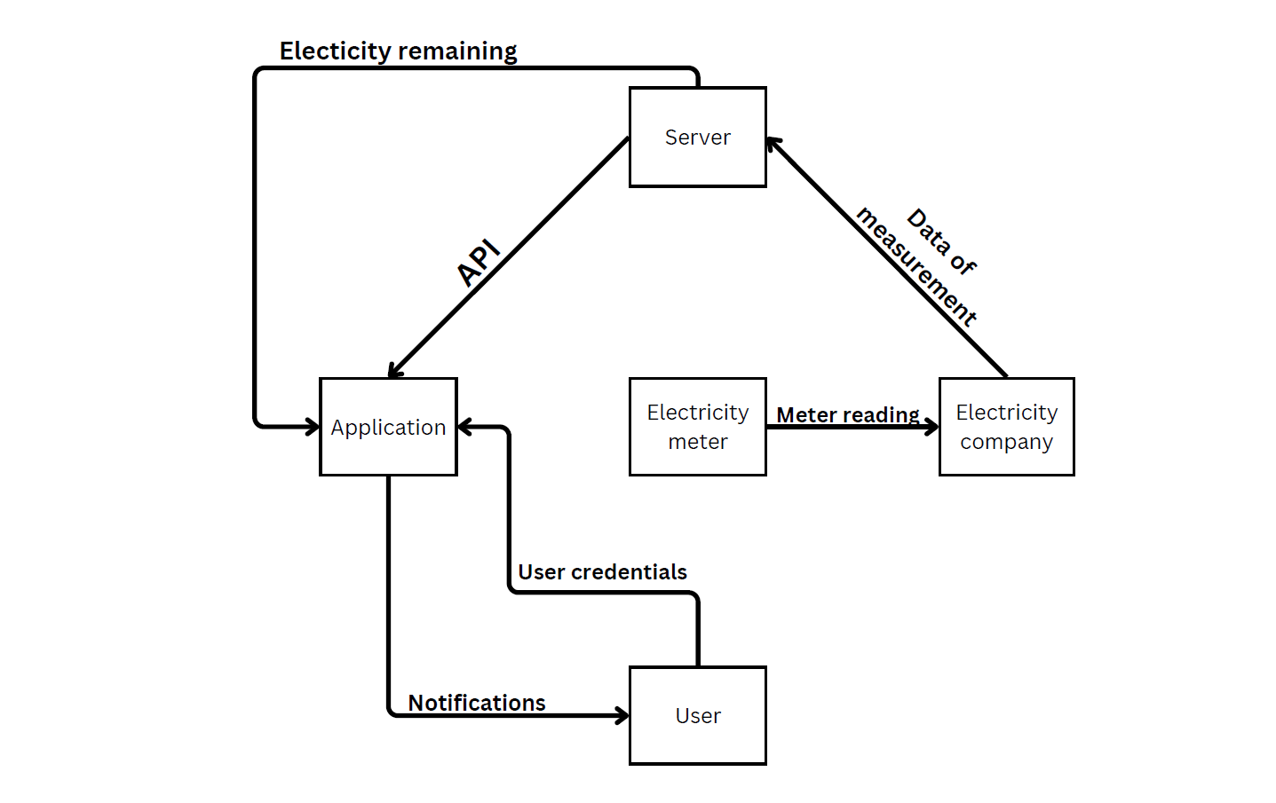
Data Flow Diagram

Slide 11
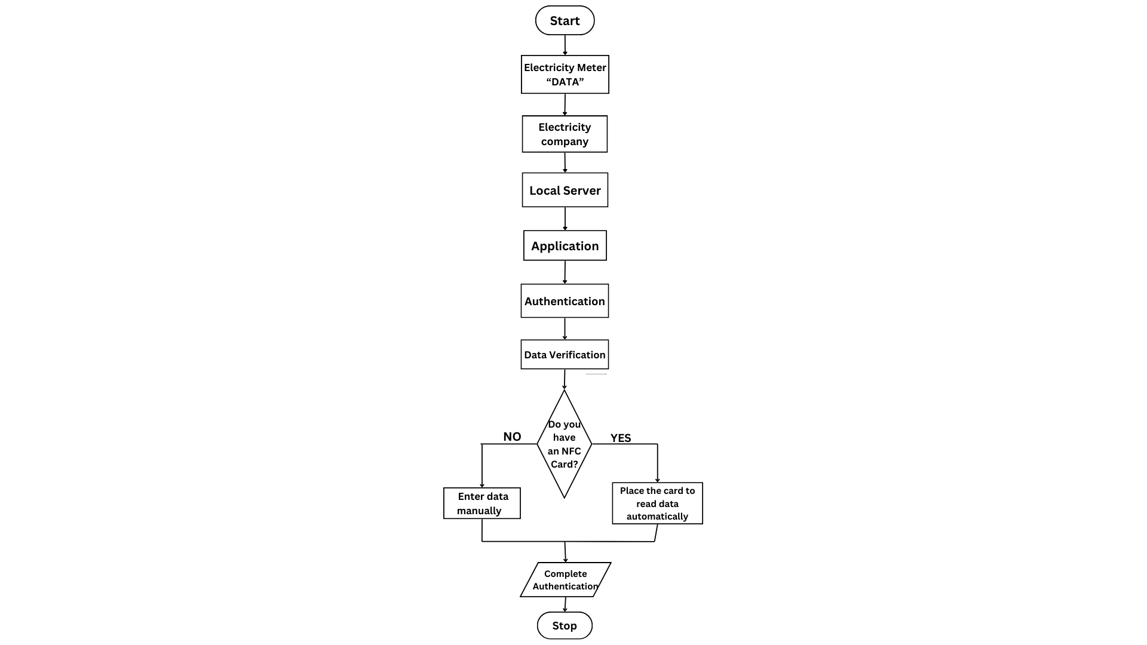
FlowChart

Slide 12
cost calculations according to Egyptian market conditions and the feasibility considerations
1. Project Management Costs
System Request and Feasibility Analysis: Cost for drafting, feasibility analysis, and consulting, if required.
Cost: EGP 5,000–15,000.
2. Technical Feasibility and Economic Analysis
Cost-Benefit Analysis Tools: Software for cash flow analysis, NPV, ROI, and break-even calculations. Open-source tools could reduce costs.
Cost: EGP 2,000–5,000.

Slide 13
cost calculations according to Egyptian market conditions and the feasibility considerations
3. Staffing and Team Costs
Development Team:
Hourly Rates for local developers (frontend, backend, AI specialists): EGP 50–200 per hour.
Project Manager: Full-time or part-time, estimated at EGP 10,000–20,000 per month.
Total Staffing Cost: EGP 50,000–150,000 depending on duration and number of team members.
4. Infrastructure and Environment
Local Server Build: Including hardware, OS licensing, cooling, and network equipment.
Hardware Setup: EGP 15,000–120,000 per server based on server grade.
Ongoing Maintenance and Power: EGP 2,000–5,000 monthly.
Security and Backup Systems: Initial setup EGP 5,000–15,000.

Slide 14
cost calculations according to Egyptian market conditions and the feasibility considerations
5. Scope Management and Project Tools
Work Breakdown Structure and Project Planning Tools (Gantt charts, network diagrams):
Software Licenses (e.g., Microsoft Project, local alternatives): EGP 2,000–8,000 per year.
Change Management and Testing Tools:
Tools to manage scope, testing feedback, and iterations, potentially open-source or low-cost software.
Cost: EGP 5,000–10,000.
6. Documentation and Infrastructure Management
Documentation Tools: Software to manage and store documentation, diagrams, and communications.
Cost: EGP 1,000–3,000 annually for document management solutions.

